Slide 1



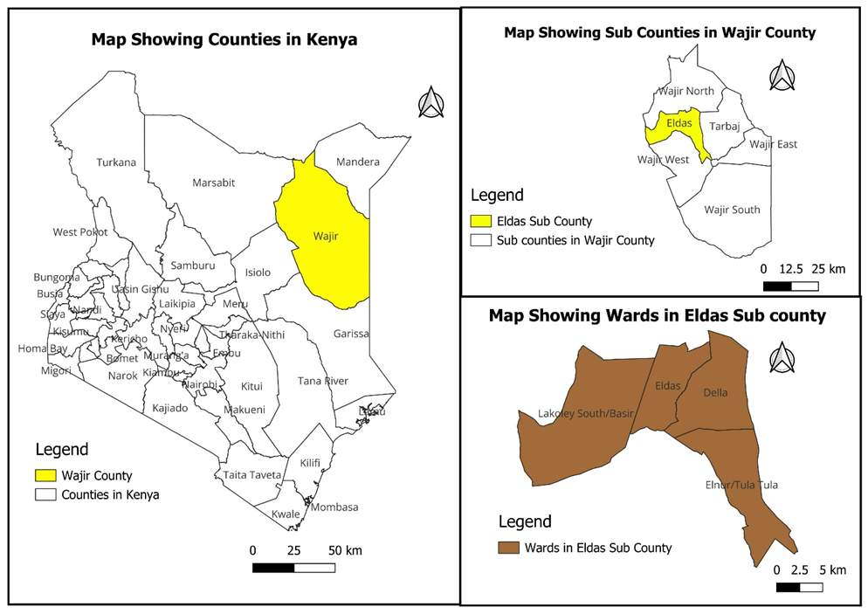


One Health Risk Assessment of Rift Valley Fever in Eldas Sub-County, Wajir County, Kenya, 2024
Stephen Okumu^{1,2}, Fredrick Odhiambo^{1,2} Mark Matheka^{1,2} and Charles Okendo²
1: Kenya field Epidemiology and Laboratory training Program 2:Kenya National Public Health Institute 3: FHI 360
BACKGROUND
Rift Valley Fever (RVF) is a climate-sensitive zoonotic disease associated with periods of above-normal rainfall and flooding. In late 2023, heavy El Niño rains resulted in widespread flooding across northern Kenya. This, combined with a confirmed RVF outbreak in neighboring Marsabit County in January 2024, significantly increased the risk of disease spread to Wajir County.
Given the ecological suitability and population vulnerability, there was an urgent need to assess the risk of RVF transmission using an integrated One Health approach.
OBJECTIVE: To assess the risk of a Rift Valley Fever outbreak in Eldas Sub-County, Wajir County, using a One Health approach integrating human, animal, and environmental data..
METHODOLOGY: A field assessment was conducted from January 24 to February 2, 2024.
STUDY AREA:Eldas Sub-County,Wajir County, Kenya
STUDY DESIGN AND SAMPLING
Design Sampling
Cross-sectional field risk assessment
Multidisciplinary One Health approach
Purposive sampling of communities, health facilities, and livestock Heard
Inclusion of human, animal, and environmental sectors
INSERT MAP OR FIGURES
Figure 1: Map of Eldas sub county in the Kenyan context
STATISTICAL ANALYSIS: Descriptive analysis of survey and laboratory data. A qualitative risk matrix was applied to integrate findings across human, animal, and environmental domains
RESULTS: The assessment identified a high-risk environment for RVF transmission.
Table 1 Risk Assessment of Rift Valley Fever in Eldas Sub-County, Wajir County, Kenya (January–February 2024)
Category | Key Findings | Implication
Human Laboratory Findings | RVF virus detected in 2 of 32 human samples (6.3%) by PCR | Confirmed active viral circulation in humans
Animal Surveillance | 268 of 2,751 animals symptomatic: • 211 goats (79%) • 39 camels (15%) • 18 sheep (7%) | Evidence of ongoing livestock transmission
Entomological Risk | 96% of respondents reported increased mosquito density after flooding | Highly favourable vector conditions
High-risk Practices | 78% handled sick animal products without protective measures | High community exposure risk
Health-seeking Behavior | Only 38% of symptomatic individuals sought formal healthcare | Delayed case detection
Health System Capacity | Understaffing, limited vector control, and inadequate laboratory capacity | Reduced outbreak response capacity
DISCUSSION
The detection of active RVF viral circulation in humans, combined with symptomatic livestock, elevated vector density after flooding, and widespread unsafe animal handling practices, creates ideal conditions for a large-scale outbreak. Existing health system weaknesses further amplify vulnerability. These findings align with known RVF epidemiology in the Horn of Africa during El Niño events.
CONCLUSIONS
The risk of an RVF outbreak in Eldas Sub-County was high, driven by confirmed viral circulation, favorable vector conditions, community exposure, and health system gaps. Urgent, integrated One Health interventions—including vector control, livestock vaccination, community risk communication, and strengthened surveillance and laboratory capacity—are needed to mitigate this imminent threat.
Contact: [steveokumu@gmail.com]

